Slide 1

ONLINE LOAN TRACKING SYSTEM
BATCH-270
CH.SAI CHAITANYA
K.MANOJ
T.VARUN KUMAR

Slide 2

INTRODUCTION
ONLINE LOAN APPLICATION
Online Loan application frameworks have been produced use of Home advance, Car advance, Education loan, Gold loan, Business advance and online Customer securing arrangement an online stage to apply for the loan.

Slide 3

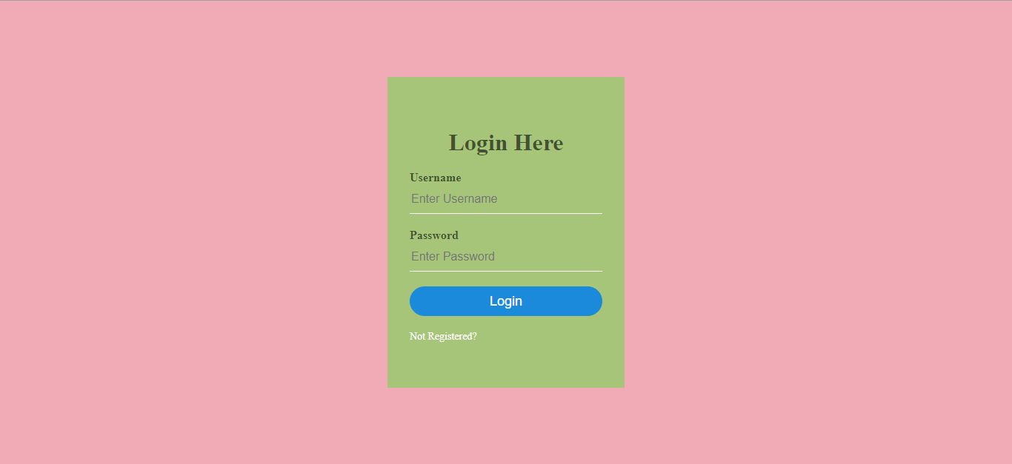
LOGIN PAGE FOR CLIENTS

Slide 4
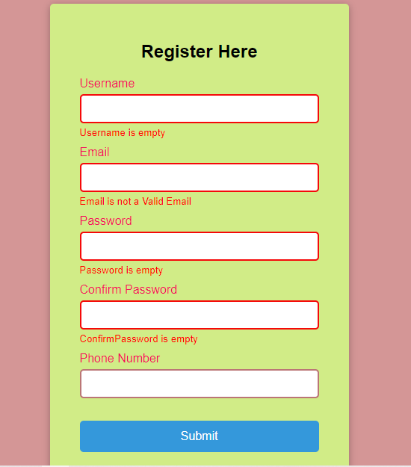
REGISTRATION PAGE FOR CLIENTS

Slide 5
SOFTWARES AND TECHNOLOGIES INVOLVED
SPRING BOOT , JDBC
ORACLE DATABASE XML
FRONT END USING BOOTSTRAP

Slide 6
MODULES INVOLVED IN OUR PROJECT
CLIENT
ADMINISTRATOR
GOLD LOAN
AUTO LOAN

Slide 7

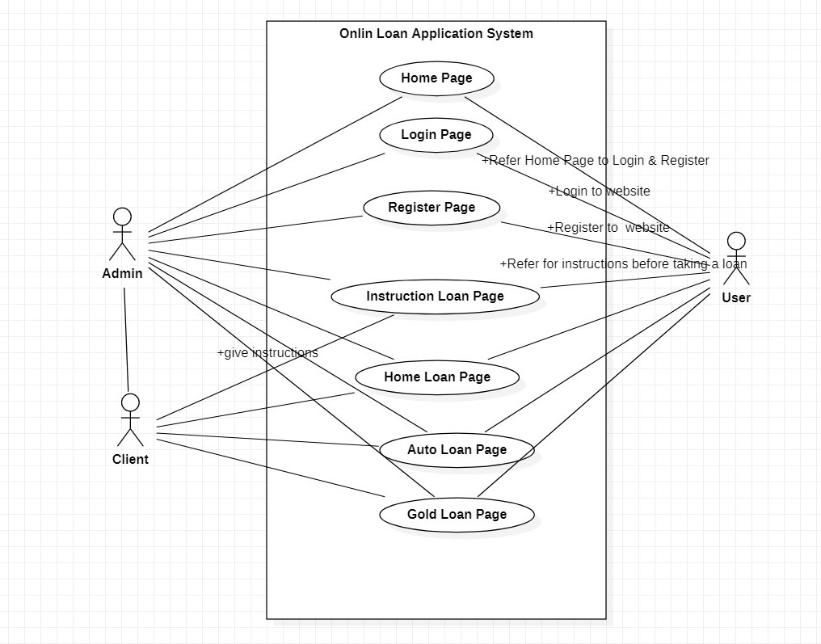
USE CASE DIAGRAM

Slide 8
WEEK WISE PROGRESS
ONE: Create the User Interface of the welcome screen.
Create a simple Sign-Up page.
Create the login page.
TWO: Perform validations of on your Login form and registration forms.
THREE: Create the tables required and connect to a database to fetch data dynamically
Identify the modules for the project
FOUR: Identify the modules for the project
FIVE: Prototype demonstration for your project.

Slide 9

SUMMARY
Online Loan application frameworks have been produced use of Home advance, Car advance, Education loan, Gold loan, Business advance and online Customer securing arrangement an online stage to apply for the loan. Loan requirement relying on their qualification clients will in a flash get to the endorsement for on the web. thereafter the bank officials will contact the client and finish all the credit formalities. after client needs to archive subtle elements advance arrange base on application framework each relies upon the others and requirement for utilizing the others. Crafted by online application underway, has been vital to the improvement of these practices. the diverse module more innovation in application. client subtle elements and issues better place settled for an agent. Development processor general supplier proposal application is that it will proceed all through the future, accommodating the individuals who require us most. the application will likewise help clients to transfer every single important report online, thus engaging the client and furthermore diminishing the advance preparing time.

Slide 10

Thank You

